Slide 1
Java Arrays & Strings

Slide 2
What is an Array?
Array is a data structure that holds a collection of data of the same type.
Java treats arrays as objects. This means array variables are reference variables, not value variables.
Individual data items in arrays are called elements.
Elements are stored consecutively (contiguously) in memory.
Each element of an array is indexed. Indexing begins at 0.
myArray
0
1
2
3
4
5
6
7

Slide 3
Declaring Arrays
datatype[] arrayname1, arrayname2;
Example:
int[] myArray1, myArray2;
datatype arrayname[];
Example:
int myArray1[], x, myArray2[];
NOTE: Declaring an array does not create it! No memory is allocated for individual array elements. This requires a separate creation step.

Slide 4
Creating Arrays
arrayName = new datatype[arraySize];
Integer value indicates the number of elements
Example:
myList = new double[8];
myList
1.2
2.3
NOTE: the new keyword creates an object or array. The object or array is created in a location of memory called the heap. A reference (pointer) to the array is assigned to the variable.
0
1
2
3
4
5
6
7

Slide 5
Declaring and Creating in One Step
datatype[] arrayname = new datatype[arraySize];
double[] myList = new double[10];
datatype arrayname[] = new datatype[arraySize];
double myList[] = new double[10];

Slide 6
The Length of an Array
Once an array is created, its size is fixed. It cannot be changed. You can find its size using
arrayReferenceVar.length
For example,
X = myList.length;

Slide 7
Initializing Arrays
Using a loop:
for (int i = 0; i < myList.length; i++)
myList[i] = someValue;
Declaring, creating, initializing in one step:
double[] myList = {1.9, 2.9, 3.4, 3.5};

Slide 8
Array literals
You can create an array literal with the following syntax:
type[ ] { value1, value2, ..., valueN }
Examples:
printArray( new int[] {2, 3, 5, 7, 11} );
int[ ] foo; foo = new int[]{42, 83};

Slide 9
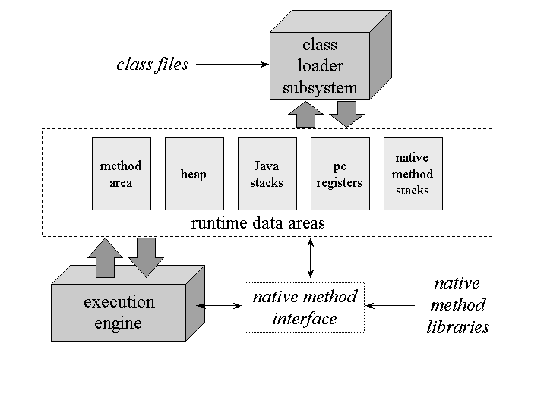
How variables are kept in memory
Two different locations of memory in JVM
Stack – contains local variables and parameters of methods
Heap – contains objects and arrays

Slide 10
Example
int main() {
int [] myArray = new int[10];
...
Stack
Heap
myArray
40 bytes

Slide 11
Using the assignment operator on arrays
Consider:
int A[] = {1, 2, 3, …};
int B[]; B = A;
A
1
2
0
B
1
2
3
4
5
6
7

Slide 12
Array Cloning
To actually create another array with its own values, Java provides the clone() method.
int[] A = {1,2,3,…};
int[] B;
B = A.clone();
1
2
1
2
A
B
0
0
1
1
2
2
3
3
4
4
5
5
6
6
7
7

Slide 13
Write your own array cloning method
A method returns an array
array parameter
int[] clone(int[] original) {
int [] result = new int[original.length]; for (int i = 0; i < original.length; i++)
result[i] = original[i];
return result;
}

Slide 14
Write your own array cloning method
// Use System.arraycopy(source_a, pos, dest_a, pos, length);
int[] clone(int[] original) {
int [] result = new int[original.length]; System.arraycopy(original, 0, result, 0, original.length);
return result;
}

Slide 15
Array Equality
Java has an equals() method for classes if (C1.equals(C2)) …
If A1 and A2 are arrays, the equals() method just compares the references.
Similar the equal operator == only compares references.
If (A1==A2)
To compare contents of two arrays, need to use a loop.

Slide 16
Declaring Multidimensional Arrays
datatype[][] arrayname;
Example:
int[][] myTable;
datatype arrayname[][];
Example:
int myTable[][];

Slide 17
Creating Multidimensional Arrays
arrayName = new datatype[rowSize][columnSize];
Integer value indicates the number of rows
Integer value indicates the number of columns
Example: myTable = new double[4][5];
Heap
0
1
2
3
4
Stack
0
1
myTable
2
3
A 2-D array is an array of arrays

Slide 18
Declaring and Creating in One Step
datatype[][] arrayname = new datatype[rowSize][columnsize];
double[][] myList = new double[10][3];
datatype arrayname[][] = new datatype[rowSize][columnSize];
double myList[][] = new double[10][3];

Slide 19
Initializing 2-Dimensional Arrays
for (int r =0; r<myTable.length; r++) {
for (int c = 0; c<myTable[r].length; c++){
myTble[r][c]=someValue;
}
}
Or
double[][] myList = {{1.9, 2.9},{3.4, 3.5}};

Slide 20
Ragged Arrays
In a 2-d array rows can vary in size
Int [] [] myTable = {{1, 2, 3},{1, 2},{1}};
0
1
2
0
1
myTable
2

Slide 21
Vectors
General purpose resizable array of objects.
User can use integer index to access items in a vector, like an array.
A vector can expand or shrink as needed when add or delete items.
Import the Vector class before use it.
import java.util.Vector; or
import java.util.*;
Declaring Vectors
Vector V = new Vector(); or
Vector V = new Vector(capacity); or
Vector V = new Vector(capacity,increment);

Slide 22
Adding, removing, and accessing vector elements
void add(int index, Object element)/boolean add(Object element)
void addElement(Object obj) (The size is increased by one.)
int capacity()
boolean contains(Object elem)
void copyInto(Object[] anArray)/Object[]toArray()
Object elementAt(int index)
Object get(int index)
int indexOf(Object elem)/int indexOf(Object elem, int index)
Void insertElementAt(Object obj, int index)
Boolean isEmpty()
Object remove(int index)/Boolean remove(Object o)/void removeAllElements()
Boolean removeElement(Object obj)/Void removeElementAt(int index)
void setSize(int newSize)
Int size()

Slide 23
Strings
Declaring Strings
String S1, S2 = "abcdef";
Creating strings
char chs[ ] = {'a', 'b', 'c'};
byte ascii[ ] = {91, 92, 93};
S1 = new String(chs);
S1 = new String(S2); v.s. S1 = S2;
S1 = new String(ascii);
chs = S1.toCharArray();

Slide 24
Strings conti.
String methods
i = S1.indexOf(ch);
if (S1.equals(S2)) {}
if (S1.equalsIgnoreCase(S2)) {}
if (S1.compareTo(S2)==0) {}
i = S1.length();
S2 = S1.substring(beginIndex, endIndex);
Converting values to Strings
S1 = String.valueOf(5);
S1 = object.toString();

Slide 25
Strings conti.
String operators
String has two operators, + and += (used for concatenation)
String S1, S2;
…
S1 += S2;
Empty Strings
An empty string has no characters; its length is 0.
String S1 = "";
String S2 = new String();
Not to be confused with an uninitialized string. (null)

Slide 26
Command line parameters
public static void main(String[] args) {
java program Hi, this is a test.
args
0
Hi,
1
this
2
is
3
a
4
test.
if args.length equals 0, there is no arguments.

Slide 27
Example
public static void main(String args[]) {
….
if (args.length==0) {
System.out.print("Year: ");
yr = stdin.nextInt();
start = 1; end = 12;
} else if (args.length==1) {
yr = Integer.parseInt(args[0]);
start = 1; end = 12;
} else {
yr = Integer.parseInt(args[0]);
start = end = Integer.parseInt(args[1]);
}
…

